Slide 1
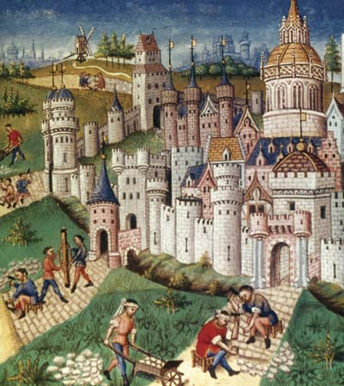
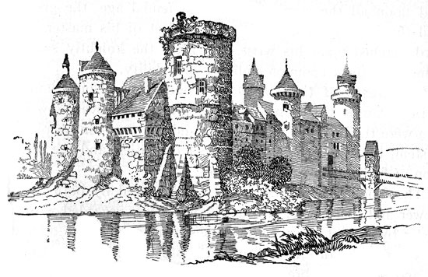
Outcome: Causes/Effects of the Middle Ages
The Middle Ages

Slide 2
Discussion Question
If our American government disappeared today, how would our lives be different tomorrow? Next month? Next year?

Slide 3
Causes/Effects of the Middle Ages
The Middle Ages: What is it?
Time period that existed between the Roman Empire and the Renaissance.
Lasts roughly 1000 years, 500-1500
Other names: The Dark Ages or medieval period.
Often seen as a very bleak and dangerous period

Slide 4
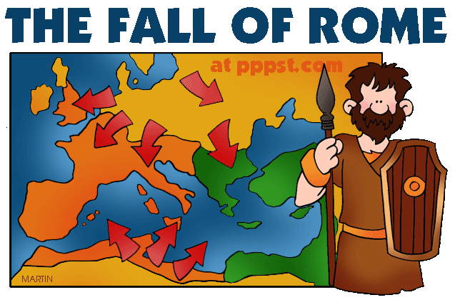
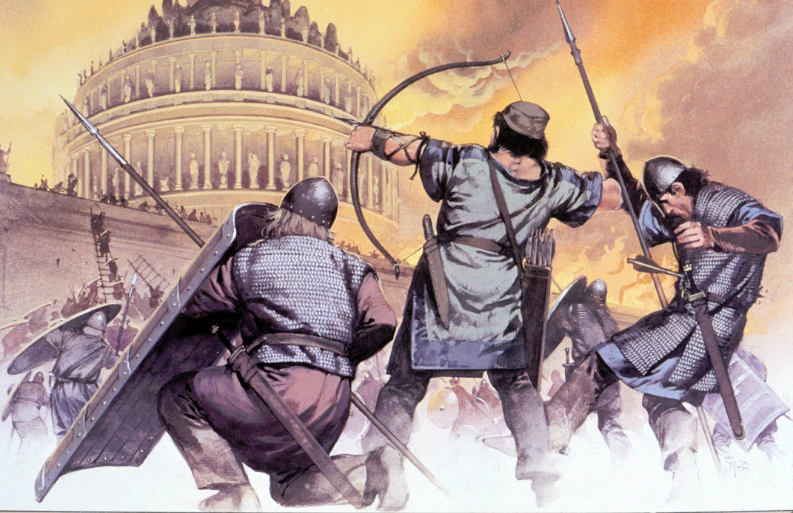
Fall of Rome

Slide 5
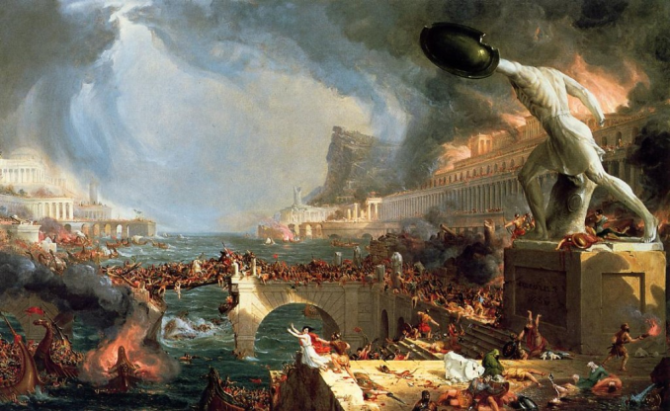
Causes/Effects of the Middle Ages
Causes of the Middle Ages
Fall of Rome was caused by invading Germanic tribes

Slide 6
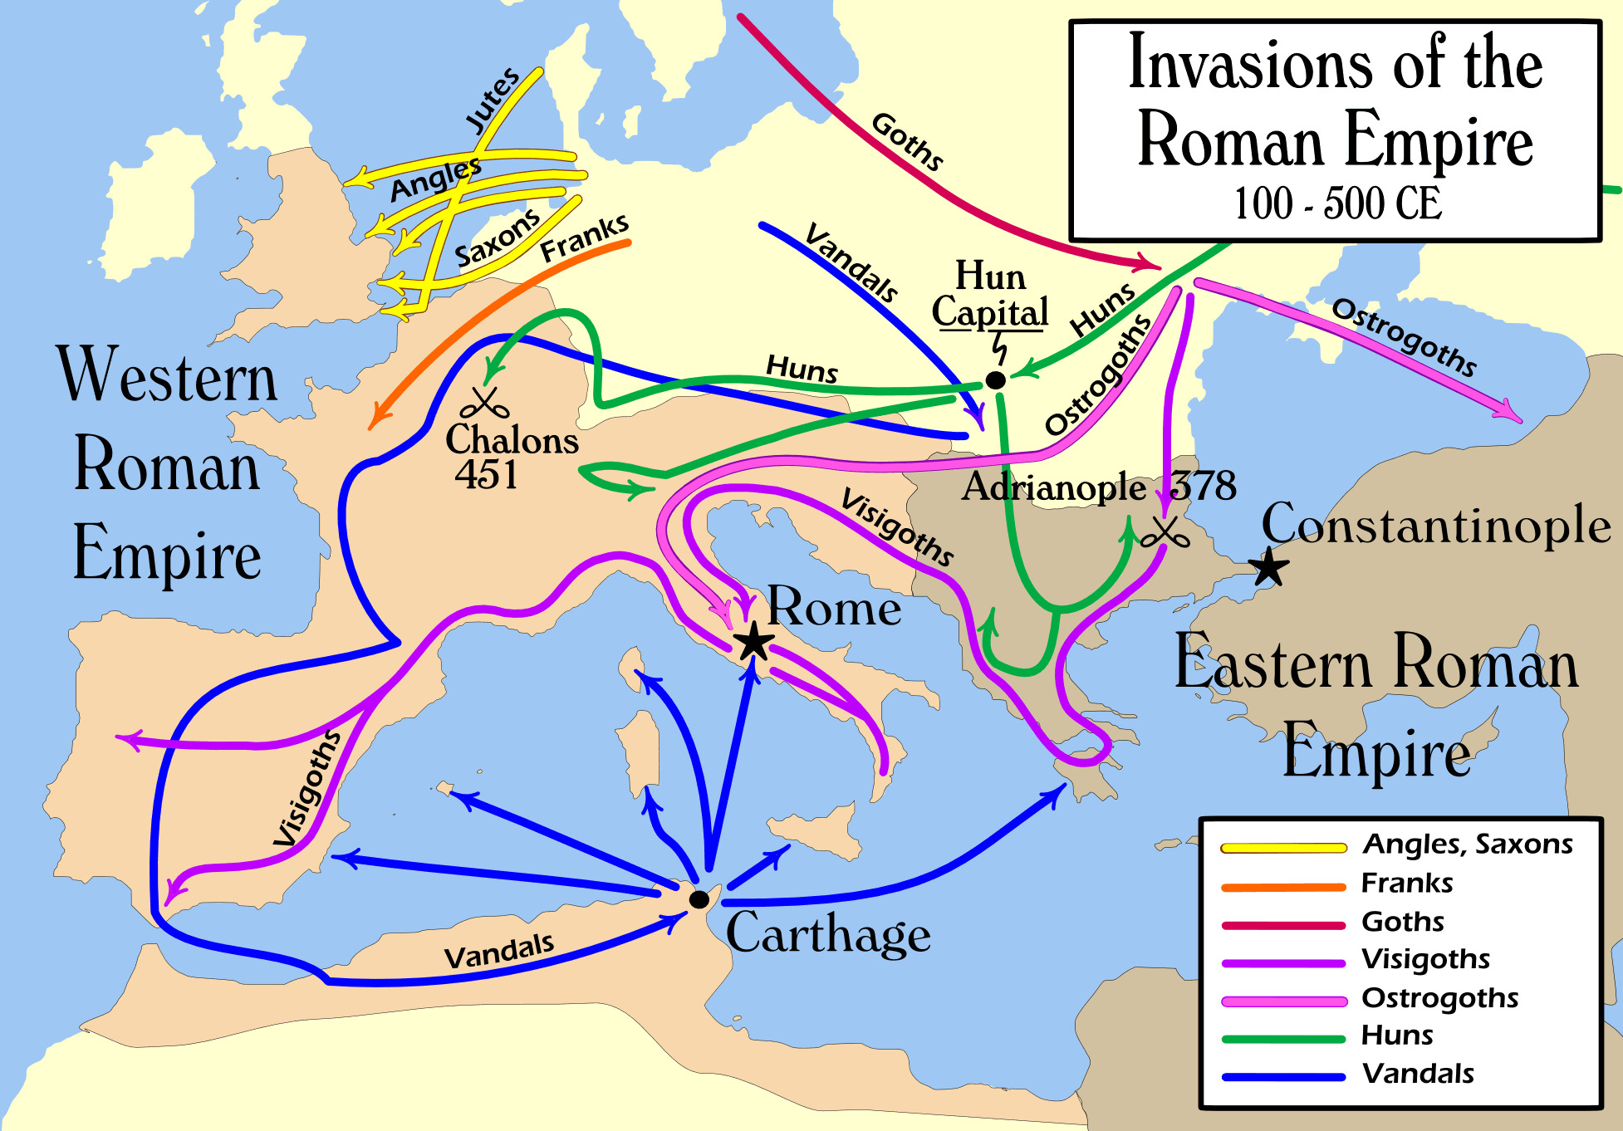
Causes/Effects of the Middle Ages
Invasions led to:
Disruption of Trade: Merchant trade collapsed and Europe’s economic centers were destroyed. Money also became scarce.
Downfall of cities: Cities were abandoned as centers of administration.

Slide 7
Causes/Effects of the Middle Ages
Europe became rural: Roman cities left without strong leadership
Decline of learning: Germanic invaders could not read or write. Learning became less important as people moved to rural areas.
Loss of a common language: Latin changed as Germanic people mixed with Roman population.
Loss of established government: Germanic tribes did not have written laws nor an orderly government for ruling purposes

Slide 8
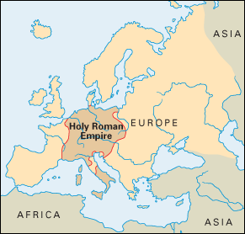
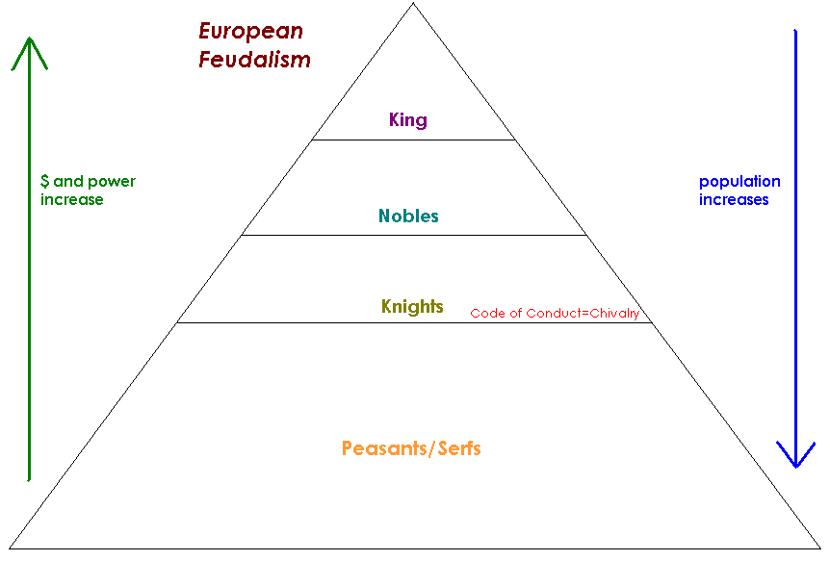
Causes/Effects of the Middle Ages
How did the Middle Ages Change Europe (Effects)?
New Germanic Kingdoms Emerge (Holy Roman Empire)
Rise of the feudal system in Europe

Slide 9
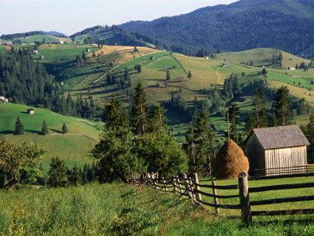
Causes/Effects of the Middle Ages
The power of the Christian (Catholic) Church grows rapidly
The power of the pope(s) grows rapidly
Europe became rural (safer?)
No major emphasis on learning

Slide 10
Causes/Effects of the Middle Ages
Effects of the Middle Ages
New languages replace Latin
Early signs of modern European countries start to appear (England & France)

