Slide 1
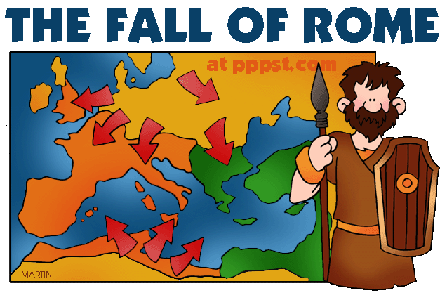
Ancient Rome & The Origin of Christianity
Outcome: The Fall of the Roman Empire

Slide 2
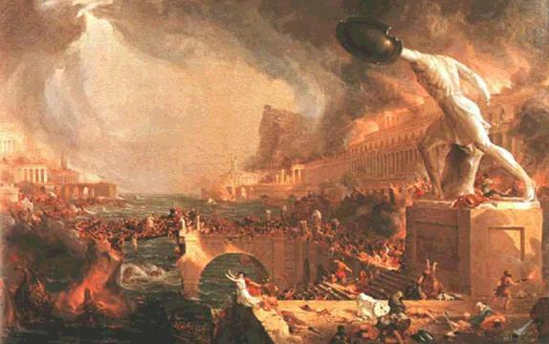
The Fall of the Roman Empire
A Century of Crisis
Pax Romana came to an end with Marcus Aurelius (AD 161-180)
The rulers that followed were unable to manage the large empire and its growing problems.
Result: The Roman Empire began to decline

Slide 3
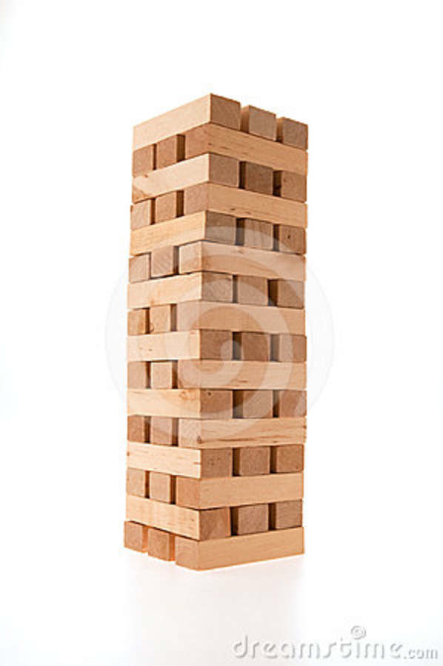
The Roman Empire Under Augustus
Stable
Secure
Powerful!

Slide 4
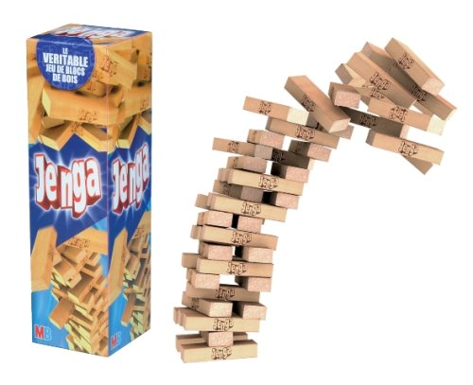
Rome Fell Like a Game of Jenga
Social Factors
Political Factors
Economic Factors
Many factors weakened Rome over the course of several centuries. By the end, it was too broken to save
Military Factors

Slide 5
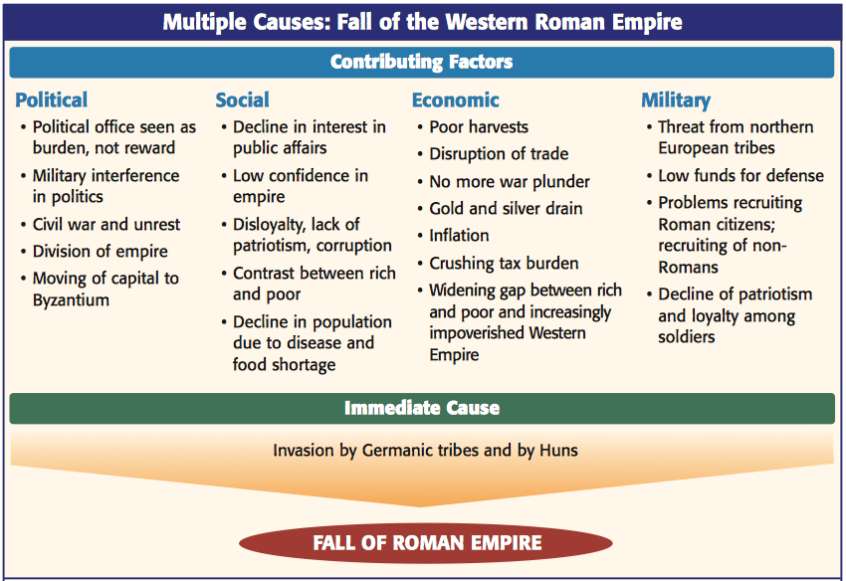
4 FACTORS WEAKENED ROME

Slide 6
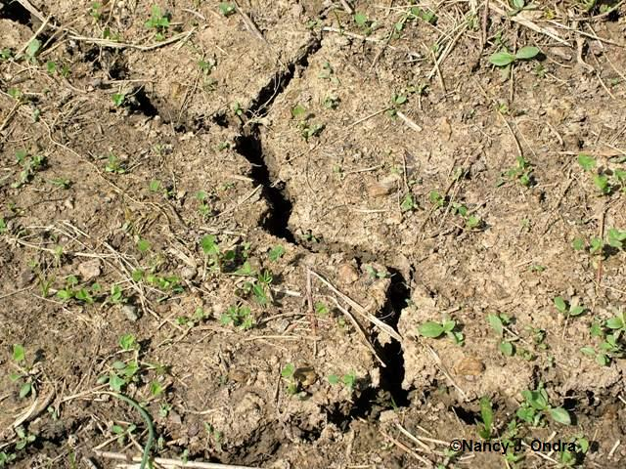
The Fall of the Roman Empire
Problems
Economic
Trade was disrupted by hostile tribes and pirates
No new gold or silver sources = raise taxes
Created more money = inflation (bad)
Soil in Italy and Western Europe became increasingly less fertile

Slide 7
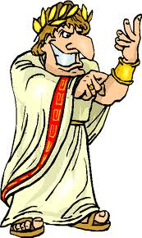
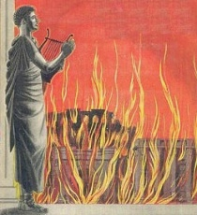
The Fall of the Roman Empire
Political
Citizens were losing their patriotism towards Rome
Government began to be controlled by military
Terrible emperors such as Nero, Commodus, & Caligula murdered, raped, and impoverished their people

Slide 8
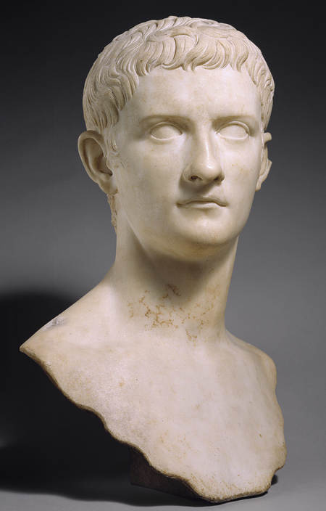
Examples of BAD EMPERORS!
Caligula
Ruled 37-41 AD
Lacked experience of collective decision making
Rumored incest with 3 of his sisters
Rumored to enjoy watching torture
Wanted to make his horse a member of the Senate
Was stabbed by imperial bodyguard while watching a gladitorial show in 41AD

Slide 9
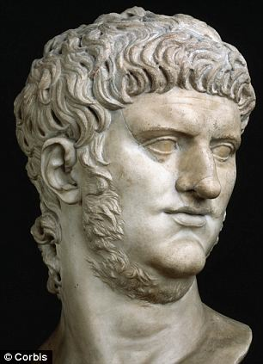
Examples of BAD EMPERORS!
Nero
Ruled from 54-68 AD
Little interest in governing, preferred to be poet & actor
Burned down part of the city to build his palace
Persecuted Christians
Killed his mother
Committed suicide after being deposed by the senate

Slide 10
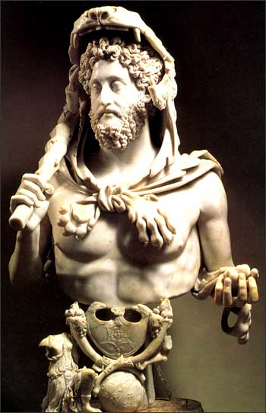
Examples of BAD EMPERORS!
Commodus
Ruled from 180-192 AD; empire begins to erode, ends Pax Romana
Wasn’t very bright
Ran a “hands-off” government
Not a military leader
Was vain, thought of himself like Hercules & fought in the Colosseum; renamed Rome colonia Commodiana
Was assassinated by eating poison beef and strangled when it was feared he might recover from the poison

Slide 11
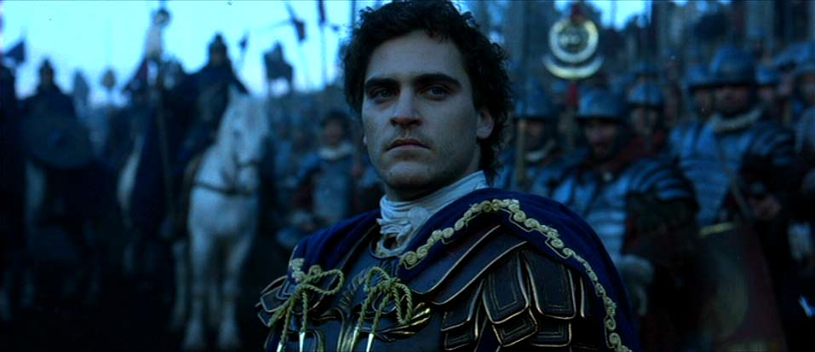
Commodus in Gladiator

Slide 12
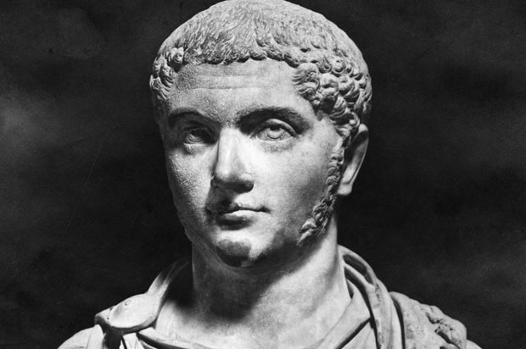
Examples of BAD EMPERORS!
Elagabulus
Ruled from 218-222 AD
Wanted to make the sun-god Elagabal the main deity in the Pantheon
Acted as if he were a god
Built a new temple for Elagabal; actions appalled the Roman subjects
Was murdered by praetorian guards in 222 AD

Slide 13
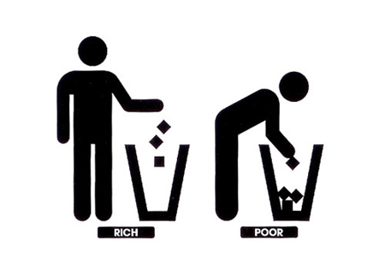
The Fall of the Roman Empire
Social
People were slowly losing their confidence in the Empire
Gap between rich and poor was still very wide
Decline in interest in public affairs

Slide 14
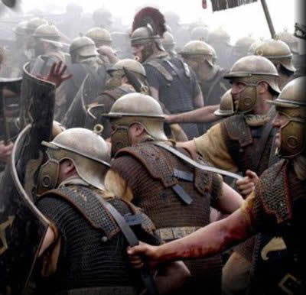
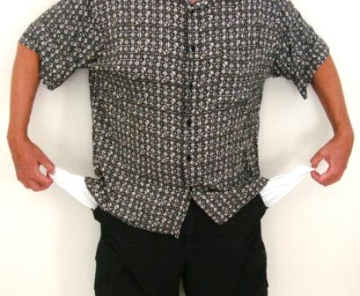
The Fall of the Roman Empire
Military
Low funds for defense
Mercenaries (foreign soldiers) hired who accepted lower pay
Soldiers were less disciplined and loyal

Slide 15
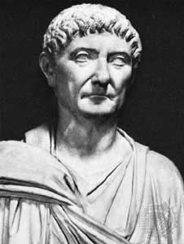
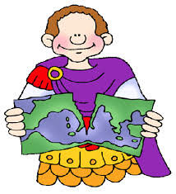
The Fall of the Roman Empire
Reform Attempted
Emperor Diocletian
Becomes emperor in 284 AD
Ruled with iron fist and limited personal freedoms
Doubled size of army
Sought to control inflation
Divided empire in two: Greek Speaking East & Latin Speaking West

Slide 16
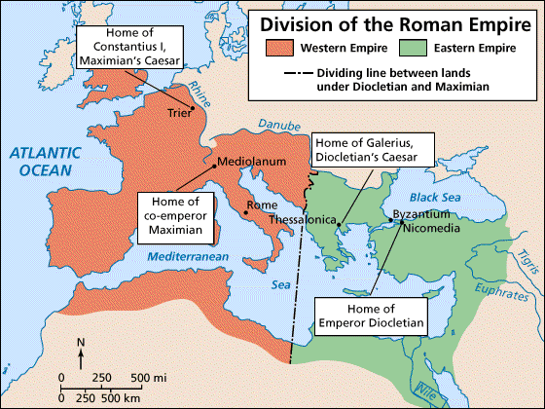
Split of the Empire

Slide 17
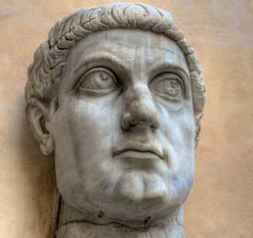
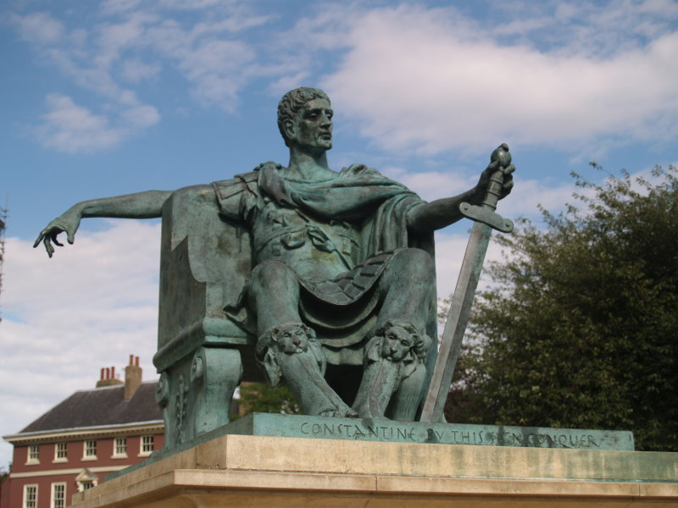
Emperor Constantine

Slide 18
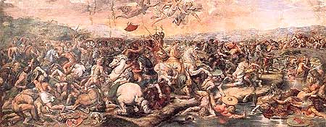
The Fall of the Roman Empire
Emperor Constantine
Embraced Christianity due to vision he had at the battle of Milvian Bridge; victory at Milvian Bridge made him sole ruler of Rome
First Christian Roman emperor
Issued the Edict of Milan which allowed Christians to worship freely
Moves capital of empire east to Byzantium; builds new city
New city is later renamed Constantinople (in modern day Turkey)
Eastern empire flourishes due to trade and wealth

Slide 19
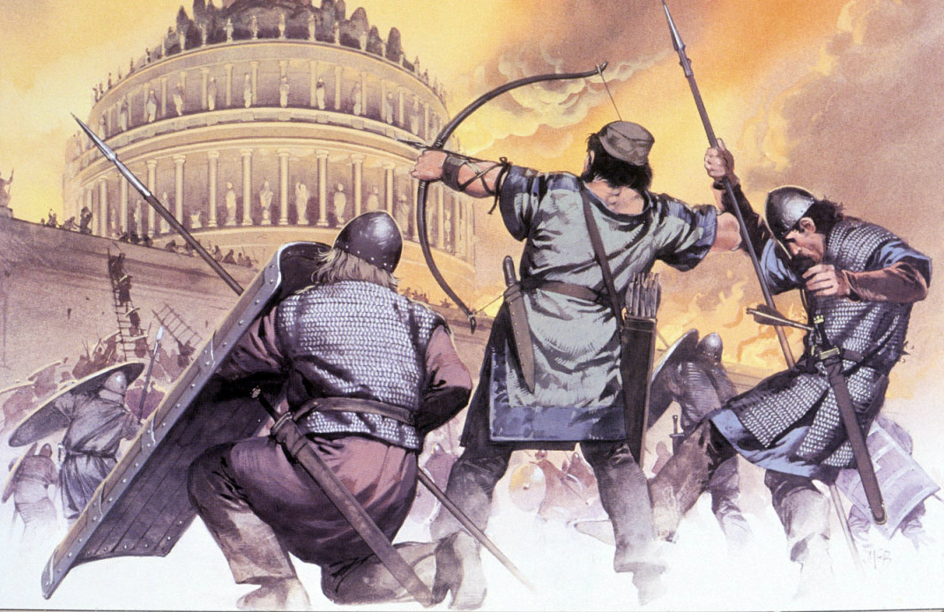
The Fall of the Roman Empire
Western Empire Crumbles
The decline of the Western Roman Empire took place over many years
Final collapse was due to:
Worsening internal problems
The separation of the Western Empire from wealthier East
Outside invasions

Slide 20
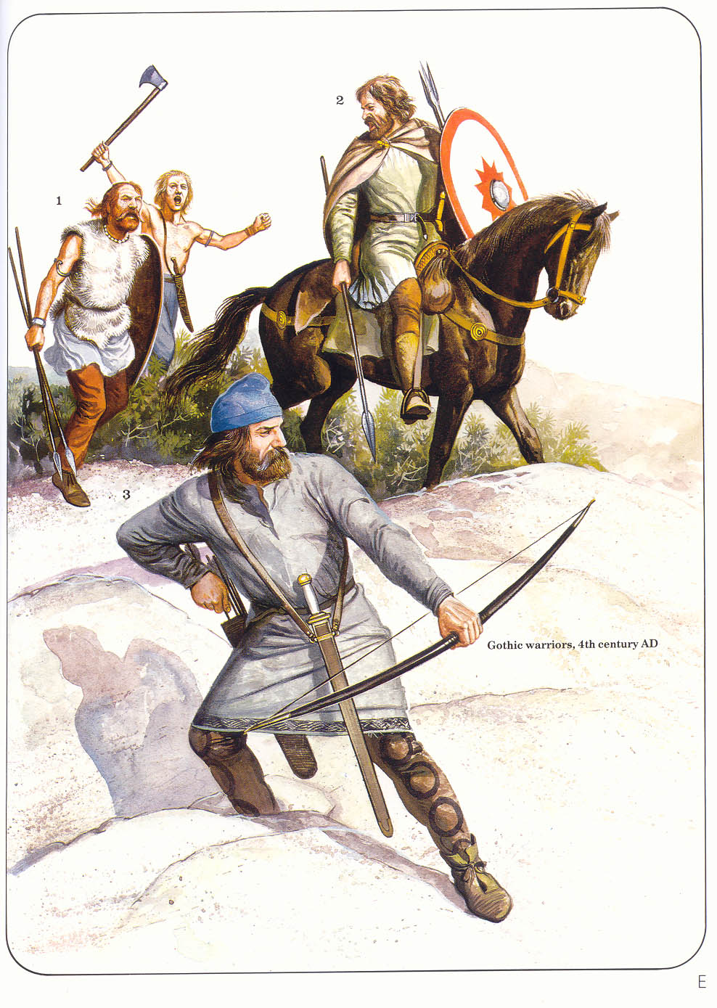
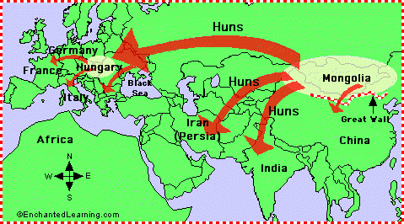
The Fall of the Roman Empire
Germanic Invasions
Mongol nomads, The Huns, forced Germanic peoples on empire’s borders to push into Roman lands
Last Roman Emperor, Romulus Augustulus, ousted by Germanic forces in 476 AD

Slide 21
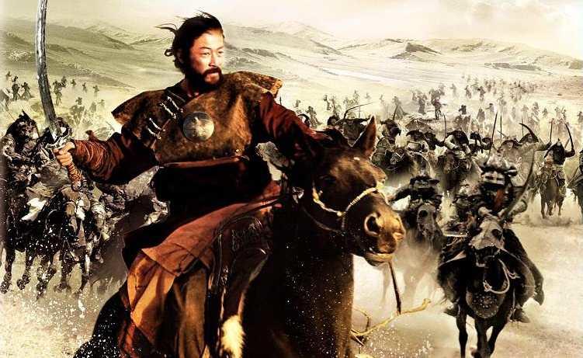
Attila the Hun

Slide 22
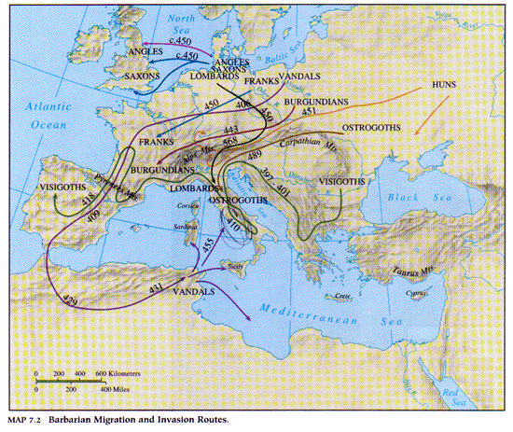
Invasion Routes

Slide 23
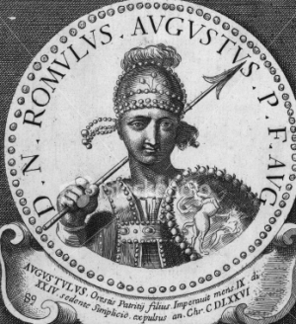
Romulus Augustulus Deposed

Slide 24
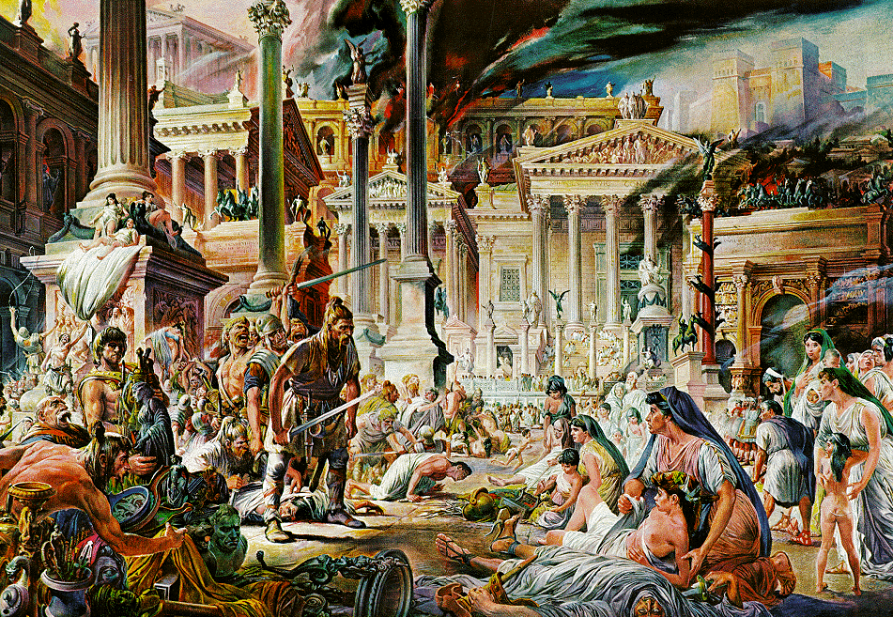

Slide 25
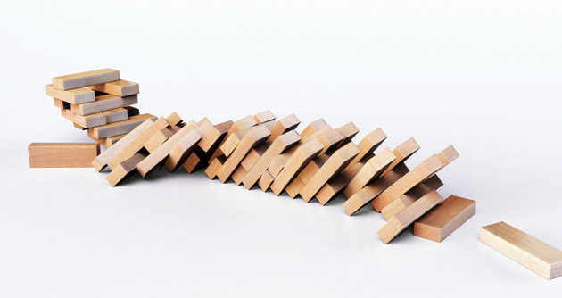
Finished.

Slide 26
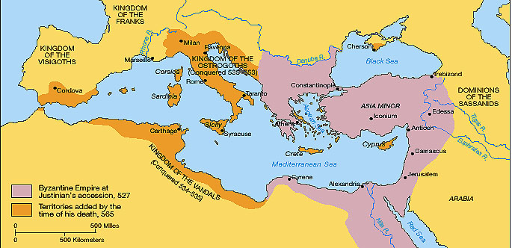
The Fall of the Roman Empire
Result: The Western Roman Empire was no more but the eastern empire would continue to thrive as a region known today as Byzantium

